Slide 1
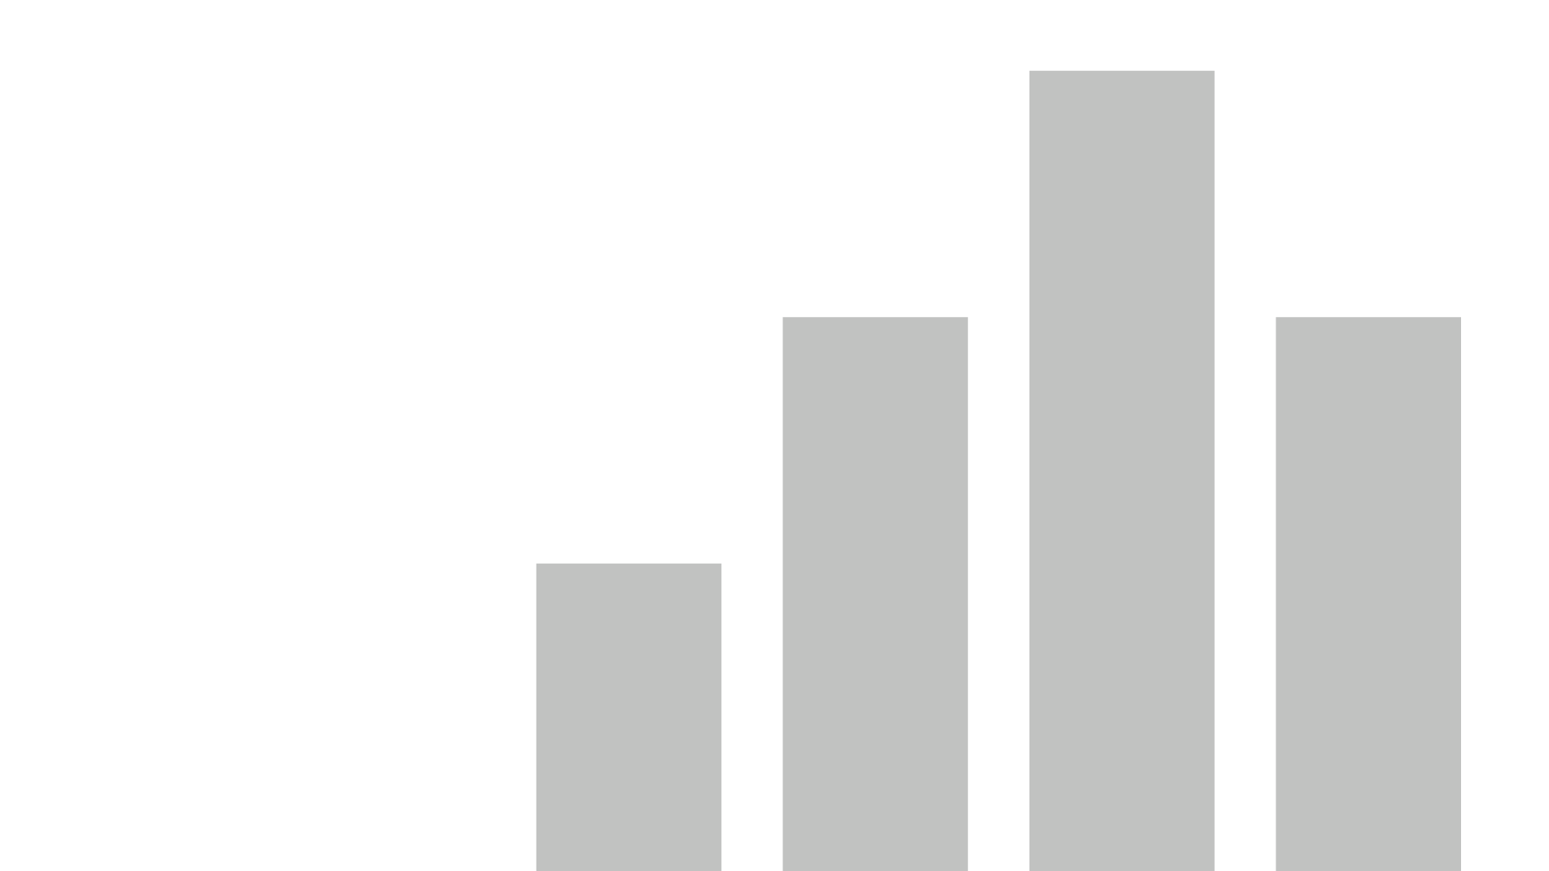


Sentiment Analysis On Malaysian 10th Prime Minister
View in Power BI
Last data refresh:
4/1/2025 10:15:36 PM UTC
Downloaded at:
4/1/2025 10:23:19 PM UTC

Slide 2
Problem statement / Project scope
When did the conversation pick up, peak, and taper off?
Where did the conversation come from?
What did the public feel about the issue?
Who generates the most buzz?
How many unique users talked about the issue?
What is the top hashtag used?
Which gender talked about the issue most?

Slide 3
Solution approach
Conversation Timeline: Use timestamps in the Excel data to pinpoint when the conversation began, peaked, and tapered off.
Source Identification: Identify the sources or platforms where the conversation emerged from based on the data.
Public Sentiment: Analyze user comments or reactions to gauge overall sentiment (positive, negative, neutral).
Key Contributors: Highlight users with the highest engagement to determine who generated the most buzz.Top Hashtags Breakdown: Identify the most frequently used hashtag.

Slide 4
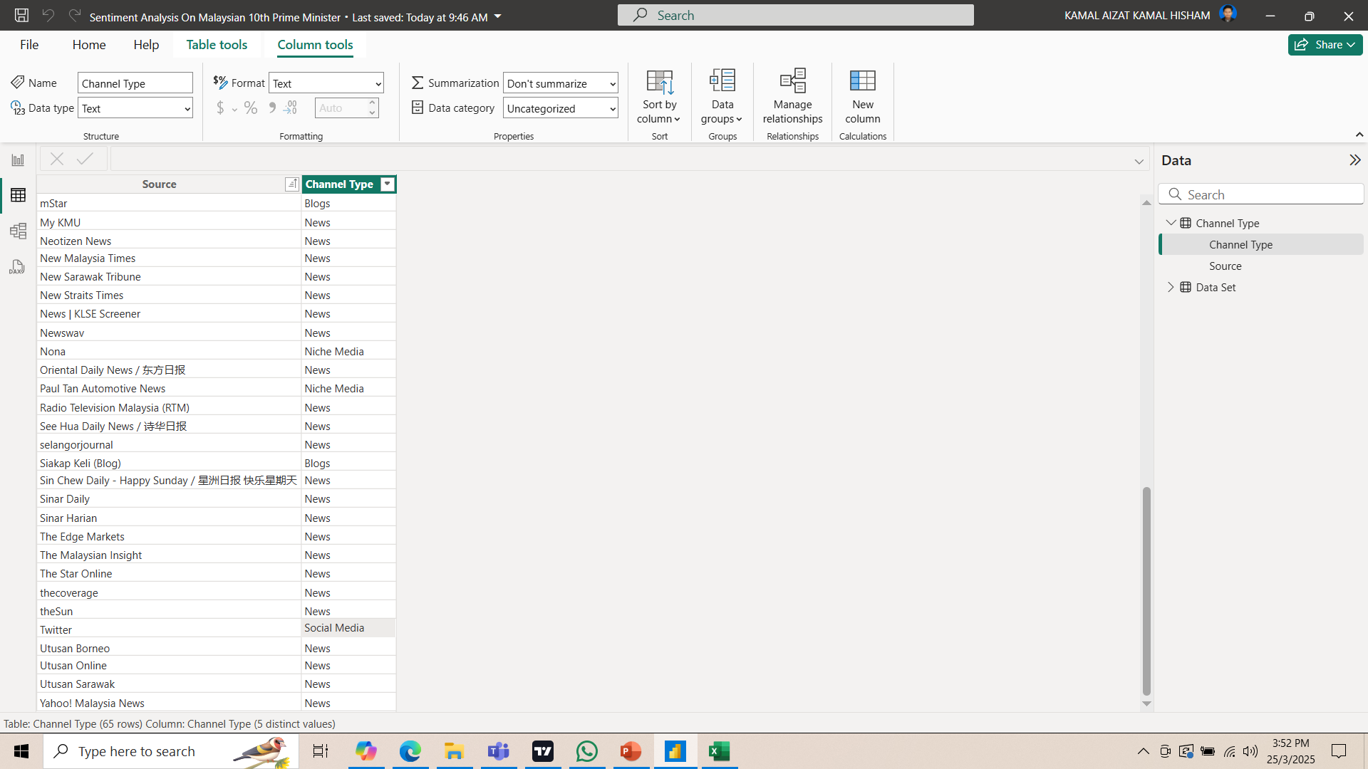
Data cleaning/transformation in Power Query

Slide 5
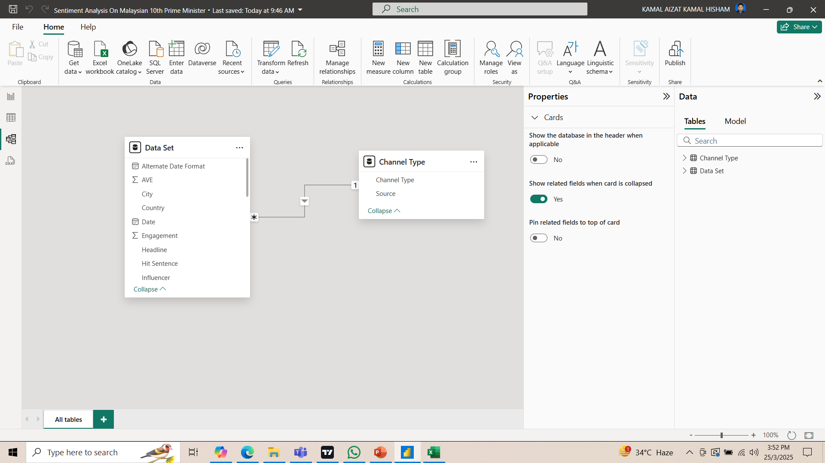
Data modelling

Slide 6
Solution OUTCOME
Conversation Trend (Top 10 Time Periods): The conversations peaked on 28-Nov-2022 between 07:37 PM and 07:46 PM with the highest activity at 07:45 PM (6487 engagements).
Where the Conversation Came From: The majority of conversations occurred on Twitter (61000 total engagements), followed by blogs (30 total engagements), and News (4 total engagements).
Public Sentiment: Most conversations were neutral (9,417 mentions), followed by positive (5,334) and negative (5,095). There were also some unrated comments (154).

Slide 7
Solution OUTCOME
The top influencer was @SyedSaddiq with 6.5k post engagements, followed by @redzuannewsMPB of 6.1k post engagements and @RavinP_69 of 5.7k engagements.
Unique Users: A total of 9058 unique users discussed the issue.
Top Hashtags/Key Phrases: Some of the most used phrases were related to “Government" (259 mentions) and “Minister” (159 mentions) and Anwar (136 mentions)

Slide 8
Features of the dashboard
1. Conversation Trends: The conversation saw two significant peaks, with the highest engagement reaching around 6.5K before gradually declining. These spikes occurred between 1:00 AM and 7:00 AM, as indicated by the "Total Engagement over Time" graph.
2. Conversation Source: A whopping 97.81% of the conversation originated from Twitter, as highlighted in the "Total Engagement by Source" section.
3. Public Sentiment: The sentiment analysis reveals that 47.1% of the responses were neutral, 26.7% were positive, and 25.5% were negative, according to the "Percentage of Sentiment" section.

Slide 9
4. Top Influencers: The most engagement came from @SyedSaddiq, who generated 6.5K interactions, closely followed by @redzuanNewsMPB with 6.1K engagements, as shown in the "Total Engagement by Influencer" section.
5. Unique Users and Hashtag: While the exact number of unique users isn't displayed, the high engagement levels and the leading hashtags point to #government and #PrimeMinister, as illustrated in the word cloud of key phrases.

Slide 10
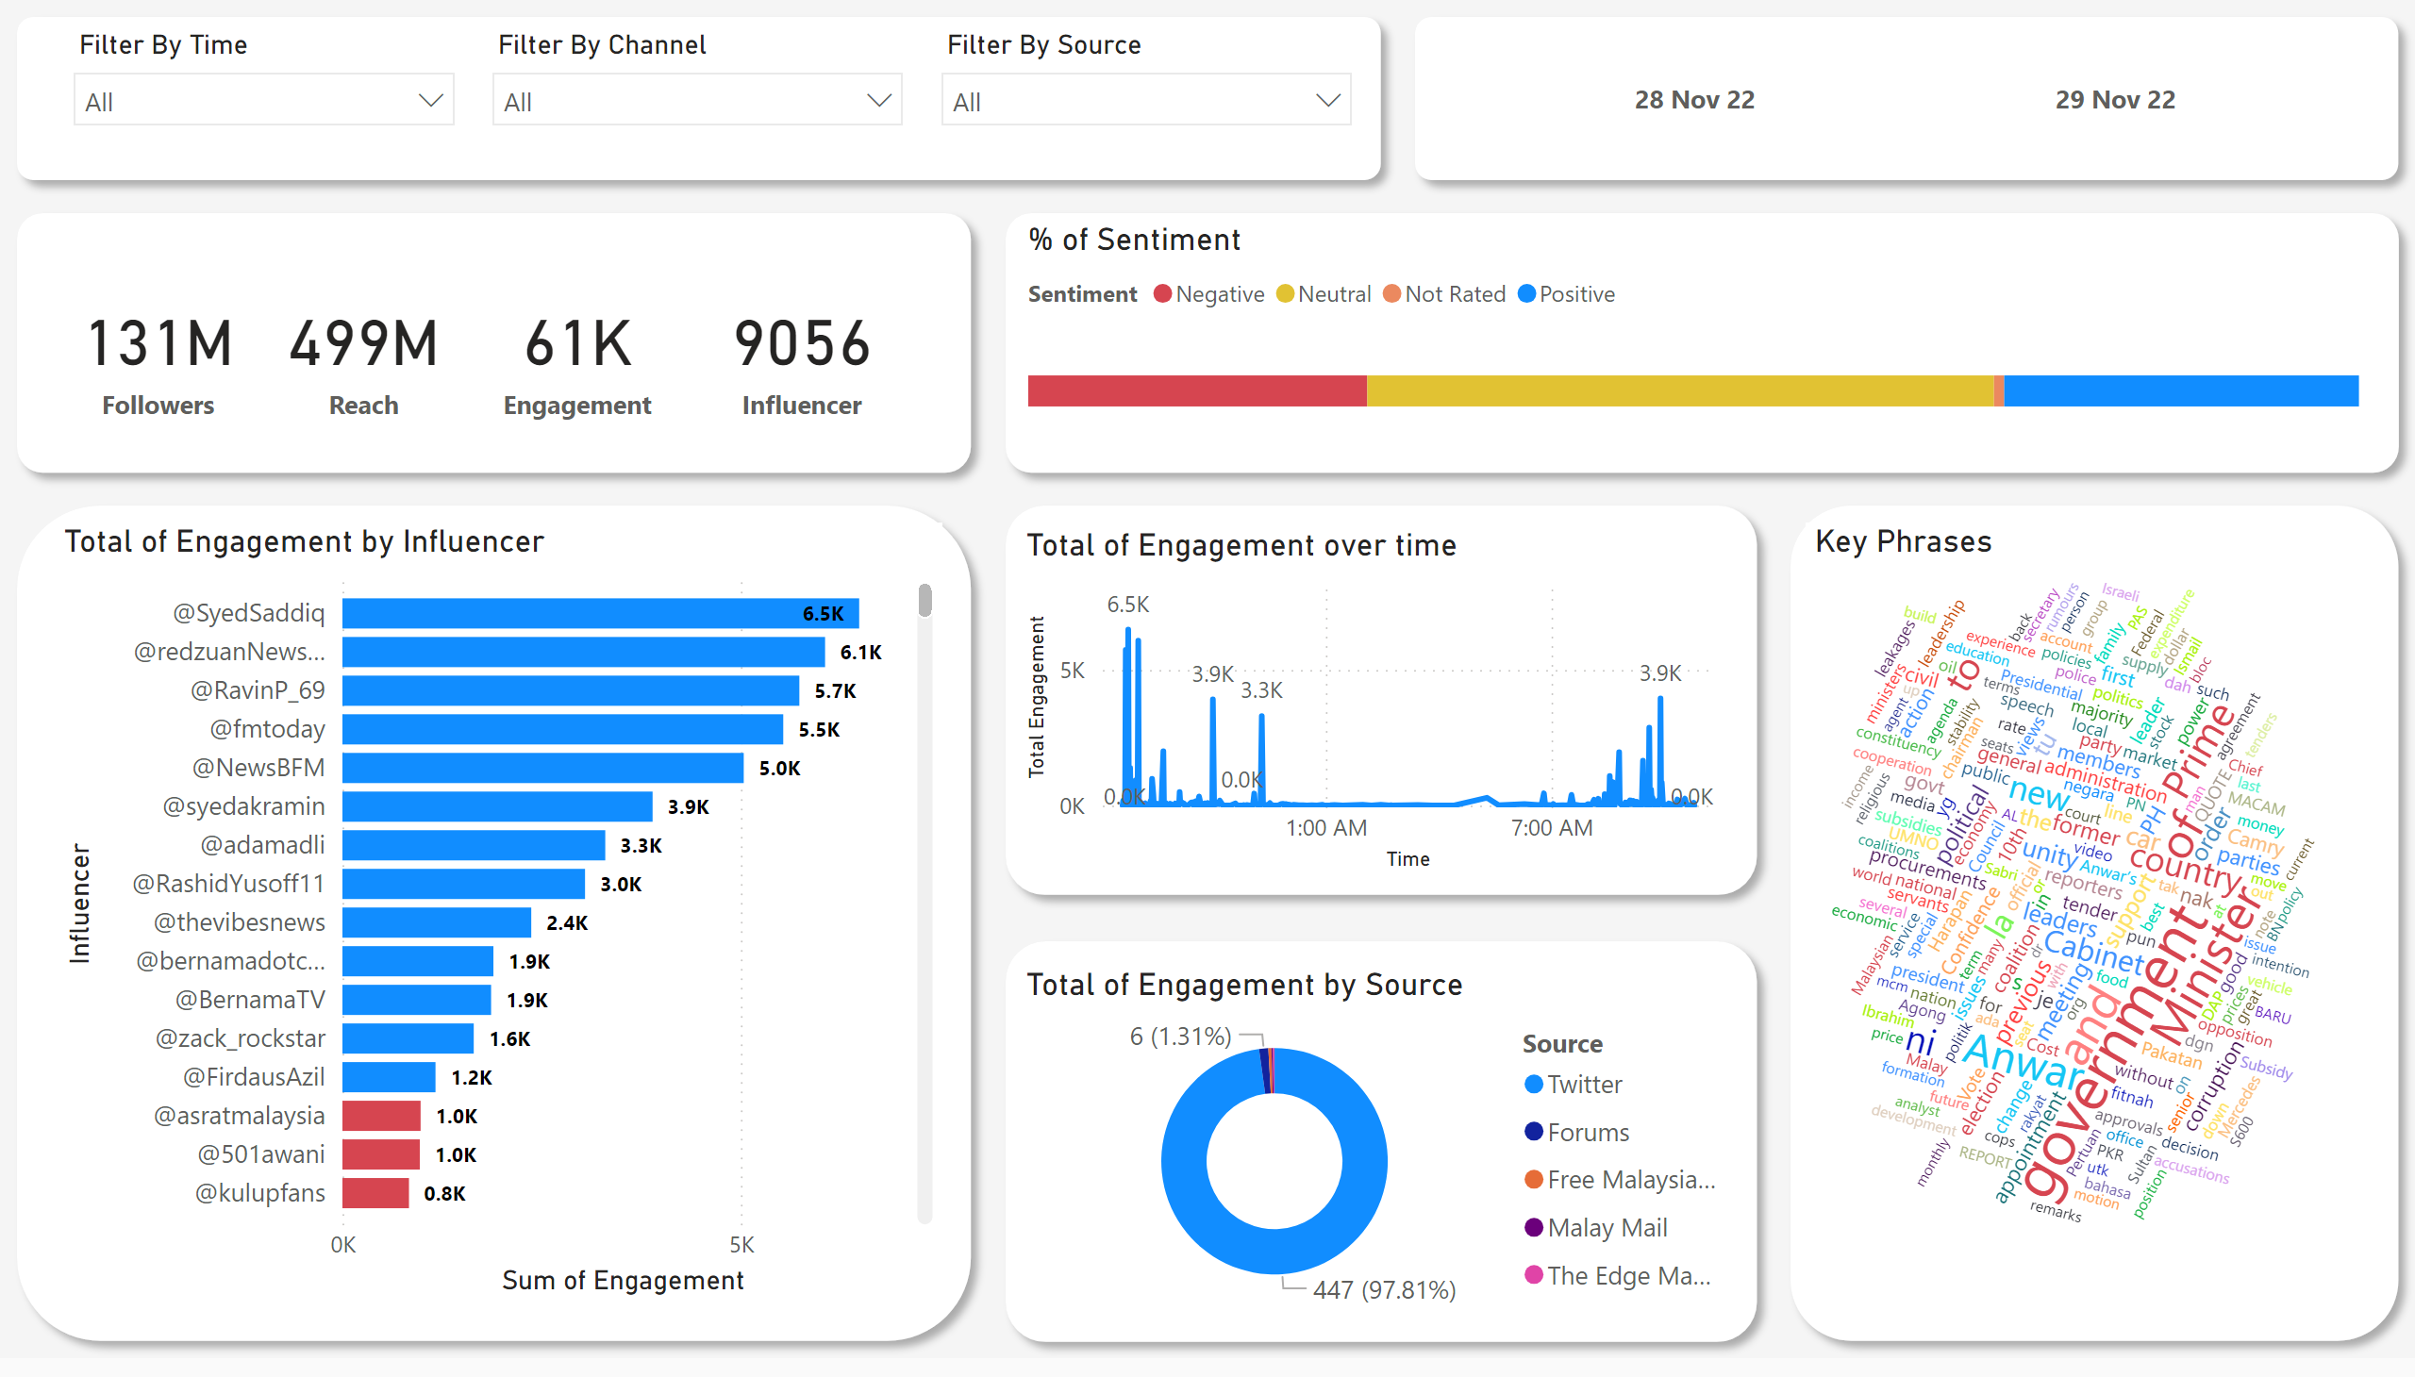
Page 1
Notes:
Total of Engagement over time
No alt text provided
Total of Engagement by Source
No alt text provided
% of Sentiment
No alt text provided
slicer
No alt text provided
Total of Engagement by Influencer
No alt text provided
card
No alt text provided
WordCloud1447959067750
No alt text provided
card
No alt text provided
slicer
No alt text provided
slicer
No alt text provided
slicer
No alt text provided
card
No alt text provided
shape
No alt text provided
shape
No alt text provided
shape
No alt text provided
shape
No alt text provided
shape
No alt text provided
shape
No alt text provided
shape
No alt text provided
shape
No alt text provided
card
No alt text provided

